Slide 1
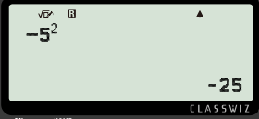
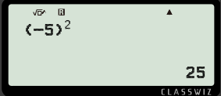
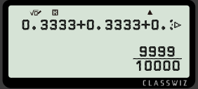
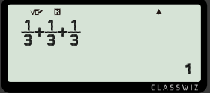
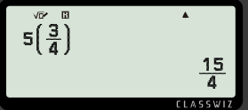
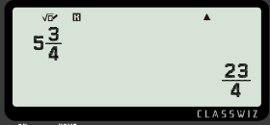

Limitations of technology in calculations
Task A: Correct inputs
1) Circle the correct and/or accurate calculation on the calculator display for the following:
a) The square of negative 5
b) 0.3333… + 0.3333…. + 0.3333…
c) 5 multiplied by ¾
2) Andeep, Jun and Jacob want to buy a cake and divide the amount equally between them.
£13
Each student pays the cake shop manager £4.33 each.
Explain why the cake shop manager is not going to give them the cake.
3 lots of £4.33 does not sum to £13.
They have not paid the full price. They are 1p short.

Slide 2
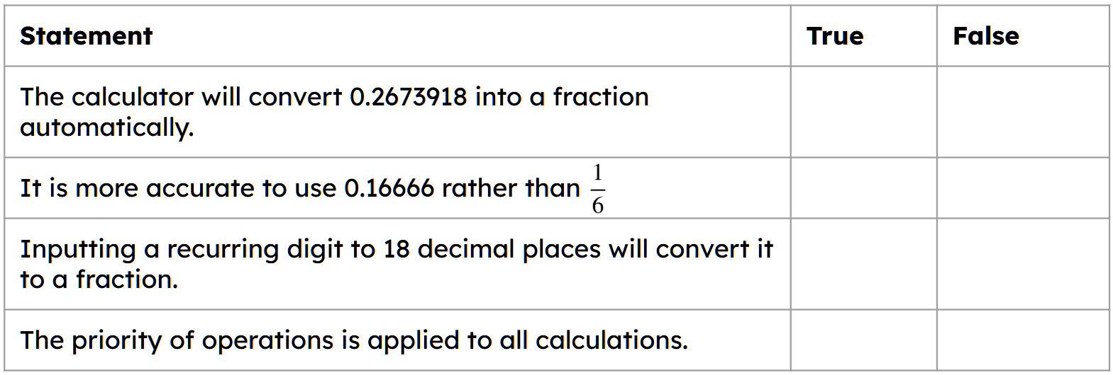

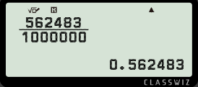
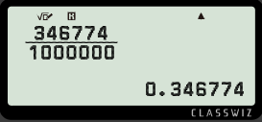
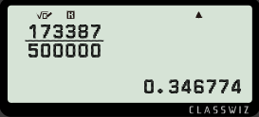

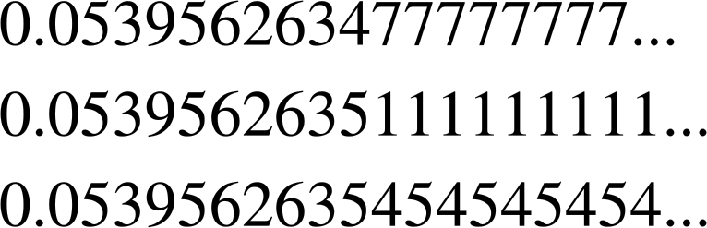
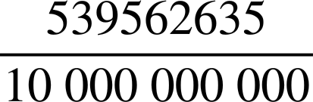
Limitations of technology in calculations
Task B: Calculator display and limitations
1) Identify if the statement is true or false when using the scientific calculator Casio Classwiz fx 991.
2) Andeep has discovered a way to find the fractional form to a decimal when the calculator does not do it automatically.
What is the fractional form of 0.346774?
What is the simplified fractional form of 0.346774?
3) A calculator displays this number
Give three examples, in decimal form, of what this number could be if it were a recurring decimal.
Give an example of a fraction it could be if it were a terminating decimal.
Some examples of a
non-terminating decimal
b) It could be this terminating decimal
Mathematics in Education and Industry
v2.2

